Slide 1
Prehospital Tourniquets in Civilians: A Systematic Review
Kenneth A. Eilertsen, MS;1 Morten Winberg, MS;1 Elisabeth Jeppesen, MPH, PhD;2,3 Gyri Hval, BSc;4 Torben Wisborg, MD, PhD5,6,7
Prehospital and Disaster Medicine | 2020

Slide 2
1. introdução
Trauma civil cada vez mais parecido com militar
Crescimento do terrorismo
Consenso de Hartford recomenda o uso de torniquetes por civis, policiais e socorristas
Diretório norueguês de saúde indica uso de torniquete pelos policiais

Slide 3
2. Métodos
PRISMA Guidelines
Critérios de inclusão:
Pacientes com mais de 16 anos de idade e hemorragias nas extremidades
Tratados com torniquete
Comparação com outros métodos de contenção de hemorragia
Resultados: mortalidade, número de transfusão de sangue, complicações da extremidade, eventos adversos
Estudos a partir de 2000

Slide 4
2. Métodos
Definições:
Estudo com civis é aquele que descreve pacientes civis tratados por não-militares, incluindo socorristas e policiais em uma zona civil
Estudo com militares é aquele que descreve pacientes (civis e/ou militares) tratados por militares em uma zona de conflito

Slide 5
2. Métodos
Estudos
Identificados 3.116, lidos 185, excluídos 112
Identificados 344 estudos em andamento e analisados.
Finalmente, 55 estudos foram analisados nesta revisão

Slide 6
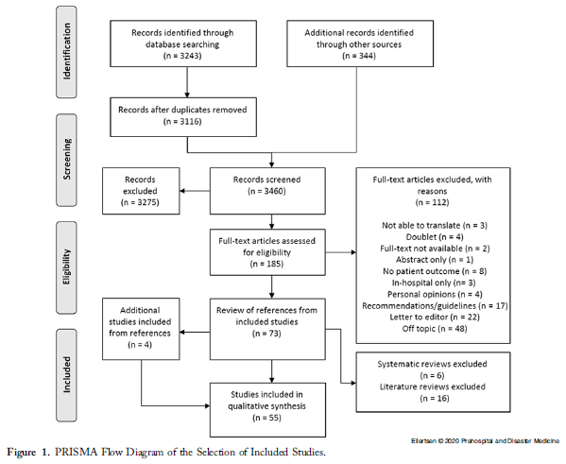

Slide 7
3. Mortalidade
50 estudos notificaram mortalidade de pacientes com torniquete
27 desses estudos não atingiram os requisitos de eligibilidade
23 foram escolhidos para avaliar a mortalidade
Índice de sobrevivência de 87% a 100%
“Overall, the military studies reported similar mortality rates in patients treated with tourniquets and patients who were not”
One study67 found that 96% of patients survived when the tourniquet was placed before the onset of shock compared to four percent of patients who received a tourniquet later
Patients treated with prehospital tourniquet (89%) also had higher survival rates than those who received a tourniquet upon arrival at the hospital (76%-78%).

Slide 8
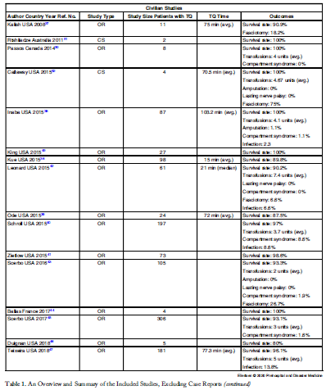
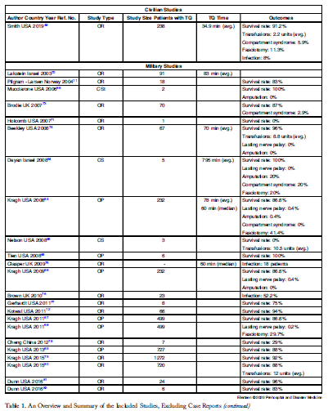

Slide 9
3. Mortalidade
Overall, studies indicated a survival benefit for patients treated with tourniquets in a civilian setting. Patients treated with prehospital tourniquet had a lower incidence of shock when arriving at the hospital compared to those who were not treated with tourniquet. 48 One study reported that death from hemorrhagic shock was more frequent in patients who received a tourniquet in-hospital (14%) compared to those who received a prehospital tourniquet (three percent).45 Most studies reported an average tourniquet application time less than two hours.

Slide 10
4. Transfusões de sangue
17 estudos reportaram necessidade de transfusões de sangue
Na maior parte dos casos civis, quem recebeu torniquete precisou de menos sangue
Nos militares o resulado é oposto

Slide 11
5. Outras complicações
35 estudos reportaram outras complicações
21 civis
14 militares
10 estudos de caso

Slide 12
discussão
O conhecimento atual não permite uma meta-análise
Nenhum estudo randomizado e controlado foi encontrado
Foi feita uma síntese descritiva
Most studies indicated that early application of a tourniquet before the onset of shock increased survival in patients bleeding from an extremity.

Slide 13
discussão
The difference in survival between patients treated with tourniquets and those without was low, possibly because patients treated with tourniquets were more severely injured. This suggests that tourniquets may play a central role in saving the lives of patients with non-controllable extremity bleeding. The studies also showed that patients with isolated extremity bleeding required fewer blood transfusions when treated with tourniquets, and that the adverse effects of tourniquet use were few and predictable.

Slide 14
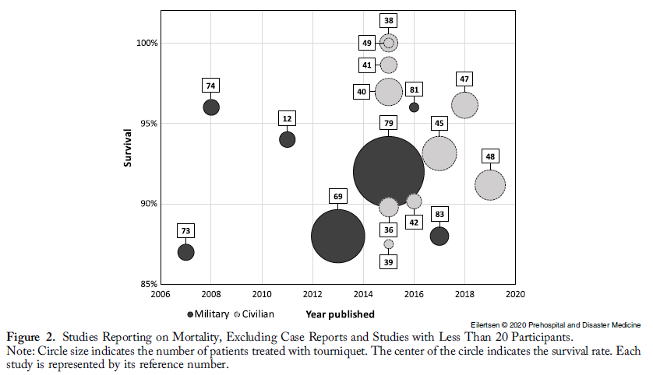

Slide 15
discussão
When comparing the military studies with the civilian studies, differences in the mechanism of injury were found. However, the indication for the use of tourniquets was similar: uncontrollable hemorrhage from the extremities. The tourniquet application time was considered to be an important factor. The application time was similar between the military and civilian studies, but considerably shorter in civilian urban areas.

Slide 16
Conclusões
Despite low level of evidence in the studies identified, the studies consistently indicated that the use of a tourniquet was associated with increased survival in uncontrollable extremity bleeding in a civilian setting. The civilian and military studies reported similar findings and treatment efficiency, though military studies tended to have longer application times. Complications to tourniquet use seemed to be tightly related to application time, and application times less than two hours seemed to be reasonably safe in previously healthy patients. Application times in urban civilian settings were short.

